Slide 1
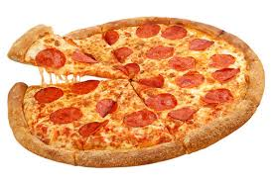

Zomato Pizza Sales Analysis
Using MS Excel by Rohit sul

Slide 2
About Zomato
Zomato is an Indian multinational restaurant aggregator and food delivery company founded in 2008.
It provides information, menus, and user reviews of restaurants, along with food delivery options from partner restaurants.
Headquartered in Gurugram, India, Zomato operates in multiple countries.
The company aims to connect customers with a wide range of food services efficiently and reliably.
Zomato holds a dominant position in India's food delivery market with an estimated 58% market share.

Slide 3
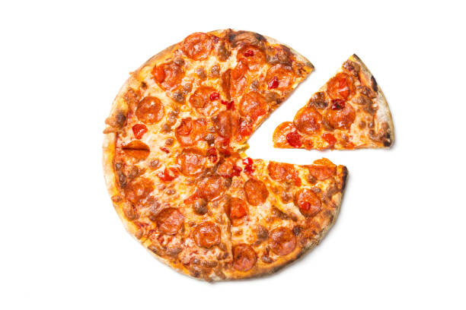
Problem Statement
The pizza sales dashboard provides a comprehensive overview of business performance across various dimensions
revenue,
order trends,
product popularity,
customer behavior.
However Zomato want to increase their pizza customer by reducing
reducing less CAC

Slide 4
Objective
To analyze and optimize pizza sales performance by understanding customer behavior, identifying low-performing and high-performing products, and tracking sales trends over time.
The goal is to enhance sales strategies, streamline inventory management, and improve overall customer satisfaction
Promoting high bestselling pizza types and reducing least selling pizza
pizza types.
Zomato want to increase their pizza market share , Inorder to increase the revenue.

Slide 5
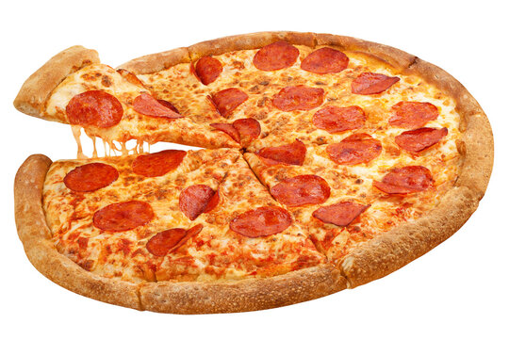
Key Areas of Concern
Identification of least and best selling pizzas based on quantity and category.
Analyzing average order value and average pizzas per order to determine purchasing patterns.
Understanding peak customer hours and daily/weekly trends for staffing and operations planning.
Monitoring monthly sales performance for forecasting and promotional planning.
Evaluating category-wise sales contribution to identify growth opportunities.

